Slide 1
Secrets of Inner Happiness

Slide 2
Stepping Forward
Past mistakes/pain
Dealing with Difficulties
Happiness
One note?
jake weiman <mjw012319@gmail.com>

Slide 3

Letting Go

Slide 4
Narrow thinking
Two huge movements:
Jews who are very engaged in the world but who are losing their Jewish identity
Jews who are very much intensifying their Jewish identity, but at the cost of disengaging from the world
http://www.rabbisacks.org/a-judaism-engaged-with-the-world/

Slide 5
Narrow Ideas
Aliza, I know this is quirky but--- ya know? the a.m. blessing of ...."thank you for not making me a gentile?"....
wwwweeeeelllll.........NOT SO FAST !!!!!!!
In your case it was a great idea! As such ,you weren't taught Judaism by ignorant or angry or otherwise poor teachers who essentially taught me that there was only one' l'av' 'love it or leave it'? (that's an attempt of sorts to do a play on words but I'm tired so the grey cells are moving slowly.....)
Unfortunately there is a gap in what I was taught or should I say was not taught ....and it is........
The only right way to love G-d and do mitzvos is : THOU MUST ...or THOU WILL :
A) SUFFER THEN GO TO HELL !
B) SUFFER
C) GO TO HELL
D) SOME VARIATION OF ALL OF THE ABOVE
I'm 54 yrs and wonder at times about gilgoolim and that 'stuff' bec. I've stuffed alot of living into a relatively short time.
In my simple single little life I have been an FFB, an 'off- the-D', now a gratefully -aging, G-d loving but a bit of a perplexed BT.

Slide 6
Inadequacies
Notes:
She asani kirtzono
Borei nefashot
Swiss cheese people

Slide 7
Holding on

Slide 8
Tension of opposites
Pulling the rope from both ends

Slide 9

Gadol HaMitzuveh
Notes:
How big are you?

Slide 10
Areivut
Notes:
613 mitzvot
We are all connected to each other now and throughout the generations
Yiridat hadorot
Each one adding, each one facing new and different challenges, completing the whole

Slide 11
Feeling directed
Notes:
Knowing the Hashem is organizing the whole direction
Everything will be all right in the end... if it's not all right then it's not yet the end.
Gam zu l’tova

Slide 12

Hashgacha Pratit

Slide 13

Hashgacha Klalit

Slide 14
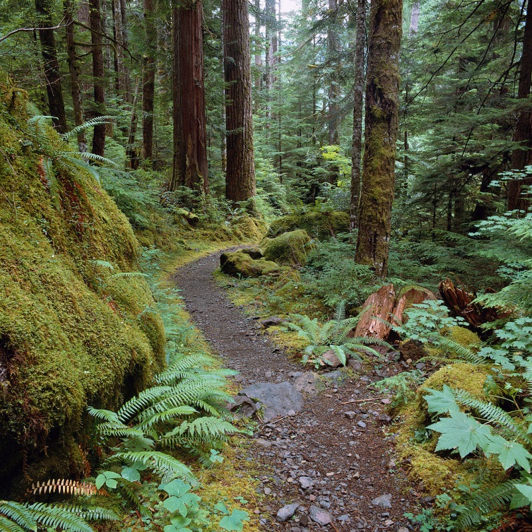
Trust and release

Slide 15
Relax
Hashem
is in charge

