Slide 1
Life Balance

Slide 2
Dreams

Slide 3
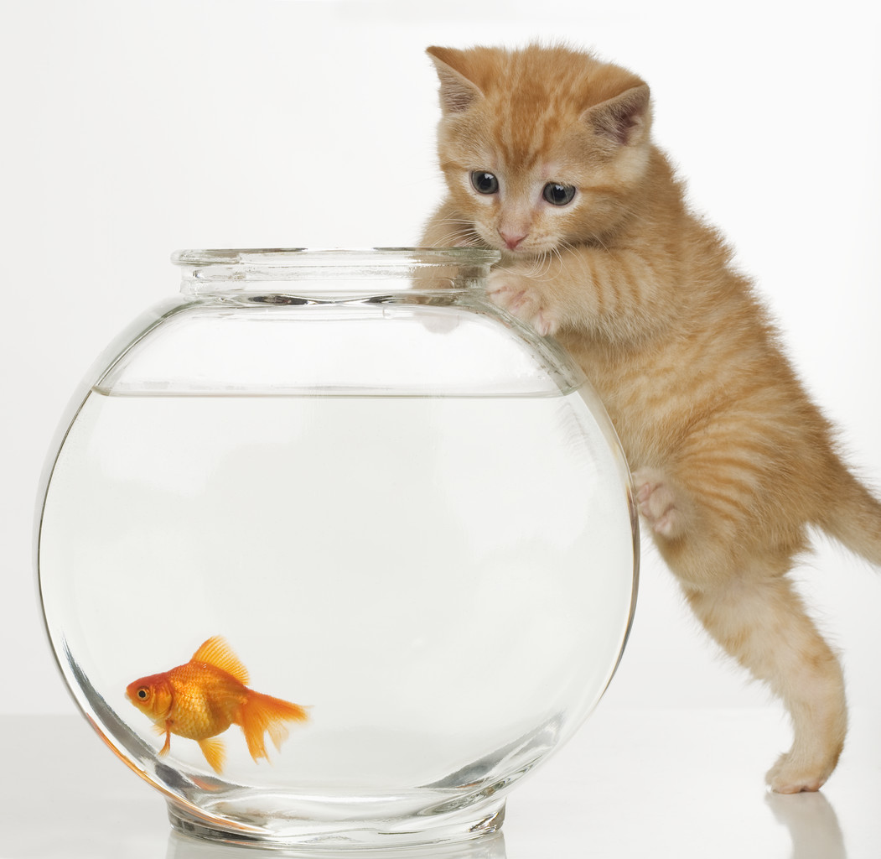
Wishes

Slide 4
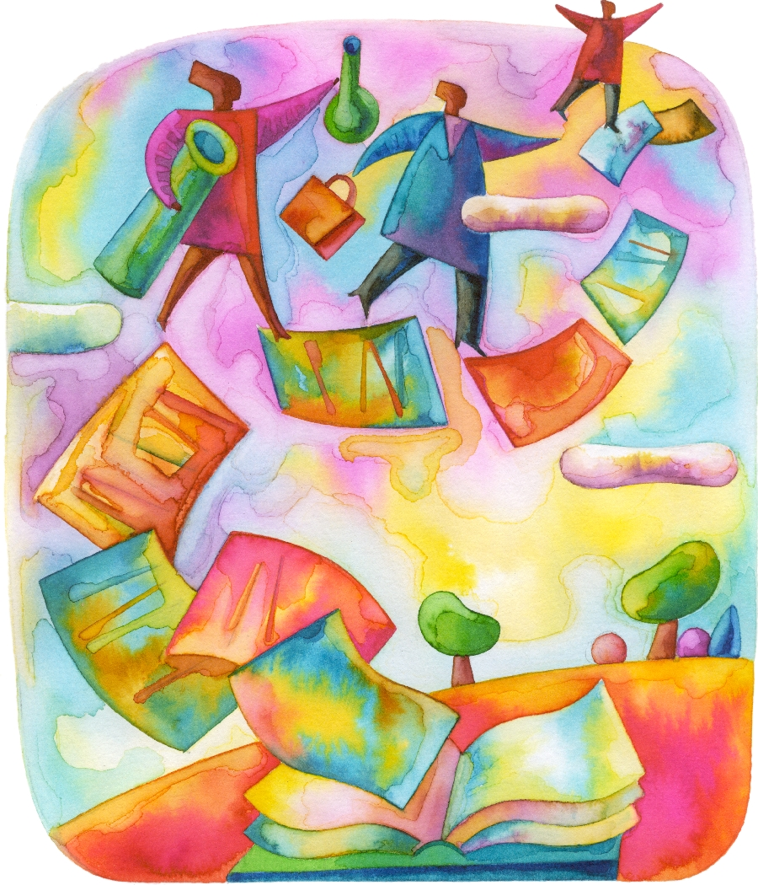
Reach

Slide 5
Goals
Microgoals-Milestones
Vibrant Community
  Bikkur cholim
  Chevrah kadisha
  School
  Kosher food
  Shul
  Mikvah
  Learning for adults at their levels
  Gamachs, chesed organizations

Slide 6
Within and Among

Slide 7
Whole Person Paradigm
Mind
Heart
Body
Spirit

Slide 8
Body-Physical
Body
  Health
  strength
  appearence
Income
Belongings
  Home
  Tools
Surroundings
  Yard, community, enviornment etc.

Slide 9
Heart-Emotional
Relationships
  Self
  Spouse or SO
  Children
  Parents
  Siblings
  Friends
  Colleagues
  Community members
  World
Feelings

Slide 10
Mind-Intellectual
Growth and Development
Learning
Understanding

Slide 11
Spirit-Soul
Connecting to Hashem
Role Modeling connection to Hashem
Helping others connect to Hashem

Slide 12
My tefillah
Learn
Understand
Remember
Live
Shine

Slide 13
Rambam Hilchot De’ot Chapter 1
Halacha 2 Between each trait and the [contrasting] trait at the other extreme, there are intermediate points, each distant from the other.
With regard to all the traits: a man has some from the beginning of his conception, in accordance with his bodily nature. Some are appropriate to a person's nature and will [therefore] be acquired more easily than other traits. Some traits he does not have from birth. He may have learned them from others, or turned to them on his own. This may have come as a result of his own thoughts, or because he heard that this was a proper trait for him, which he ought to attain. [Therefore,] he accustomed himself to it until it became a part of himself.

Slide 14
Hilchot De’ot Chapter 1
Halacha 4 The straight path: This [involves discovering] the midpoint temperament of each and every trait that man possesses [within his personality.] This refers to the trait which is equidistant from either of the extremes, without being close to either of them.
Therefore, the early Sages instructed a man to evaluate his traits, to calculate them and to direct them along the middle path, so that he will be sound {of body}.

Slide 15
Balance
Body
Mind
Heart
Soul

Slide 16

Meditation

