Slide 1
Dealing with Difficulties

Slide 2
Incorporate
Accept
Trust
Embrace
Trust more
Appreciate
Request help
Expand
Integrate
Step Forward
Repeat

Slide 3
Forgiving and Farginning

Slide 4
Choosing

Slide 5
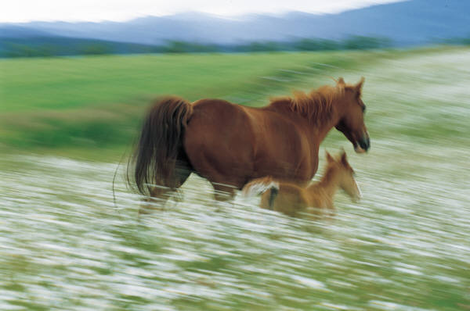
Nightmares

Slide 7
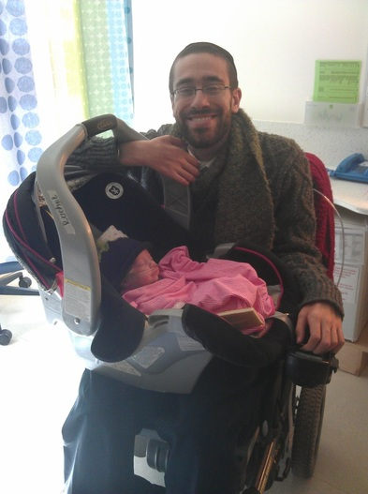
Yehoshua

Slide 8
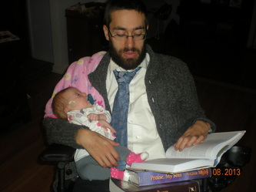

Slide 9
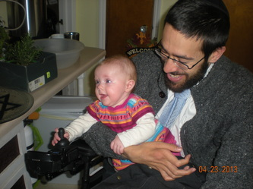
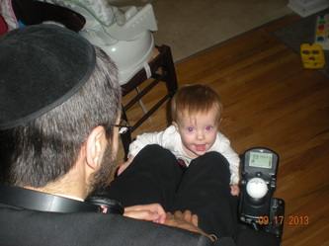

Slide 10
Yaakov

Slide 11

Resilience

Slide 12

Becoming Yourself

Slide 13
Who you wish were……… who you are

Slide 14

Who you are……… who you wish to be

Slide 15

Celebrate: Who we are

Slide 16

Brit Mila

Slide 17

Leave Behind

Slide 18
This week

